Slide 1
Workflow Paper Implementation
By Vamsi Geelpaturu

Slide 2
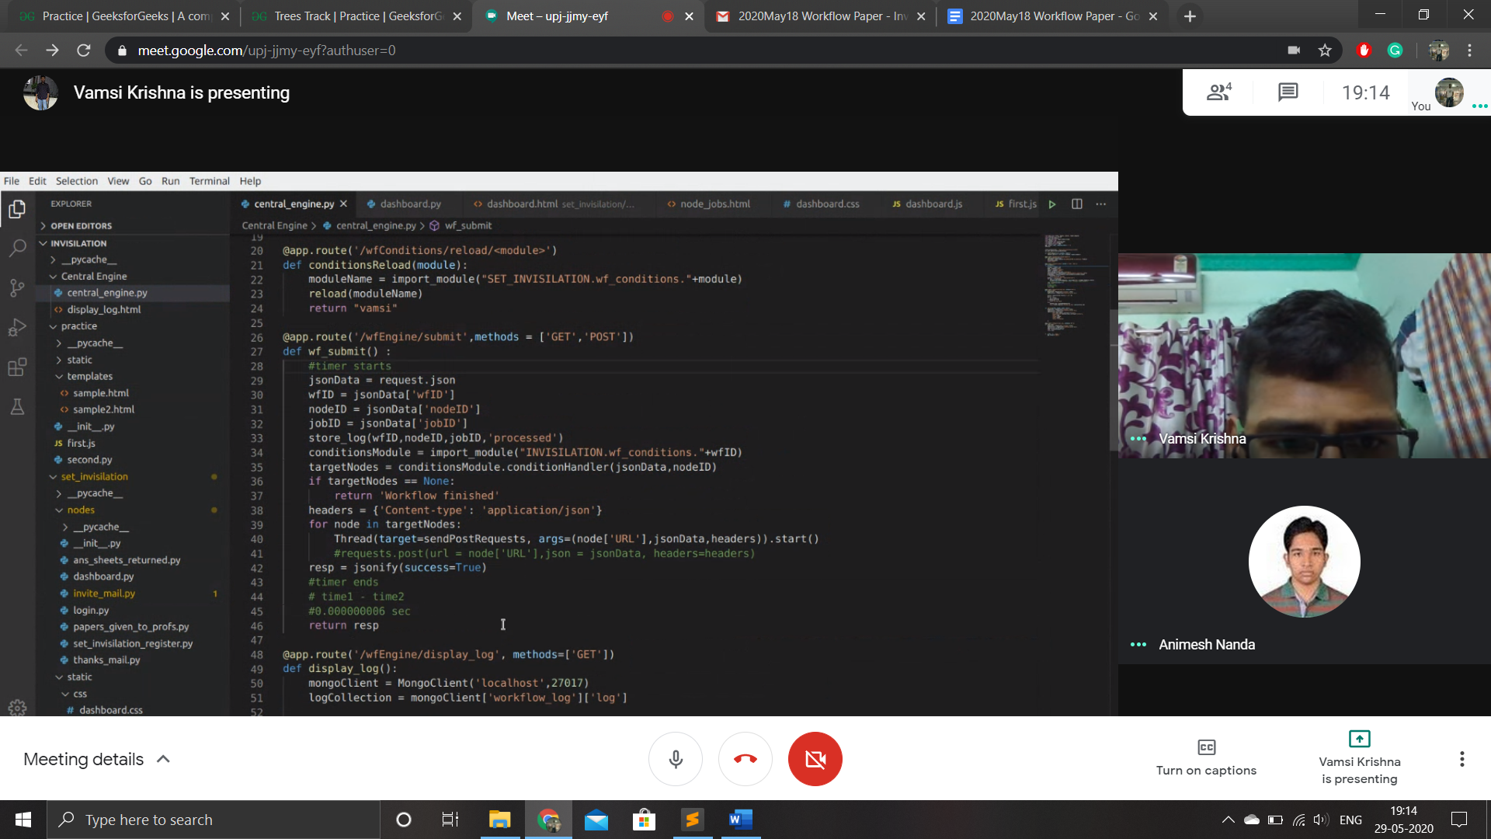
1) 1.Input data processing: y axis

Slide 3
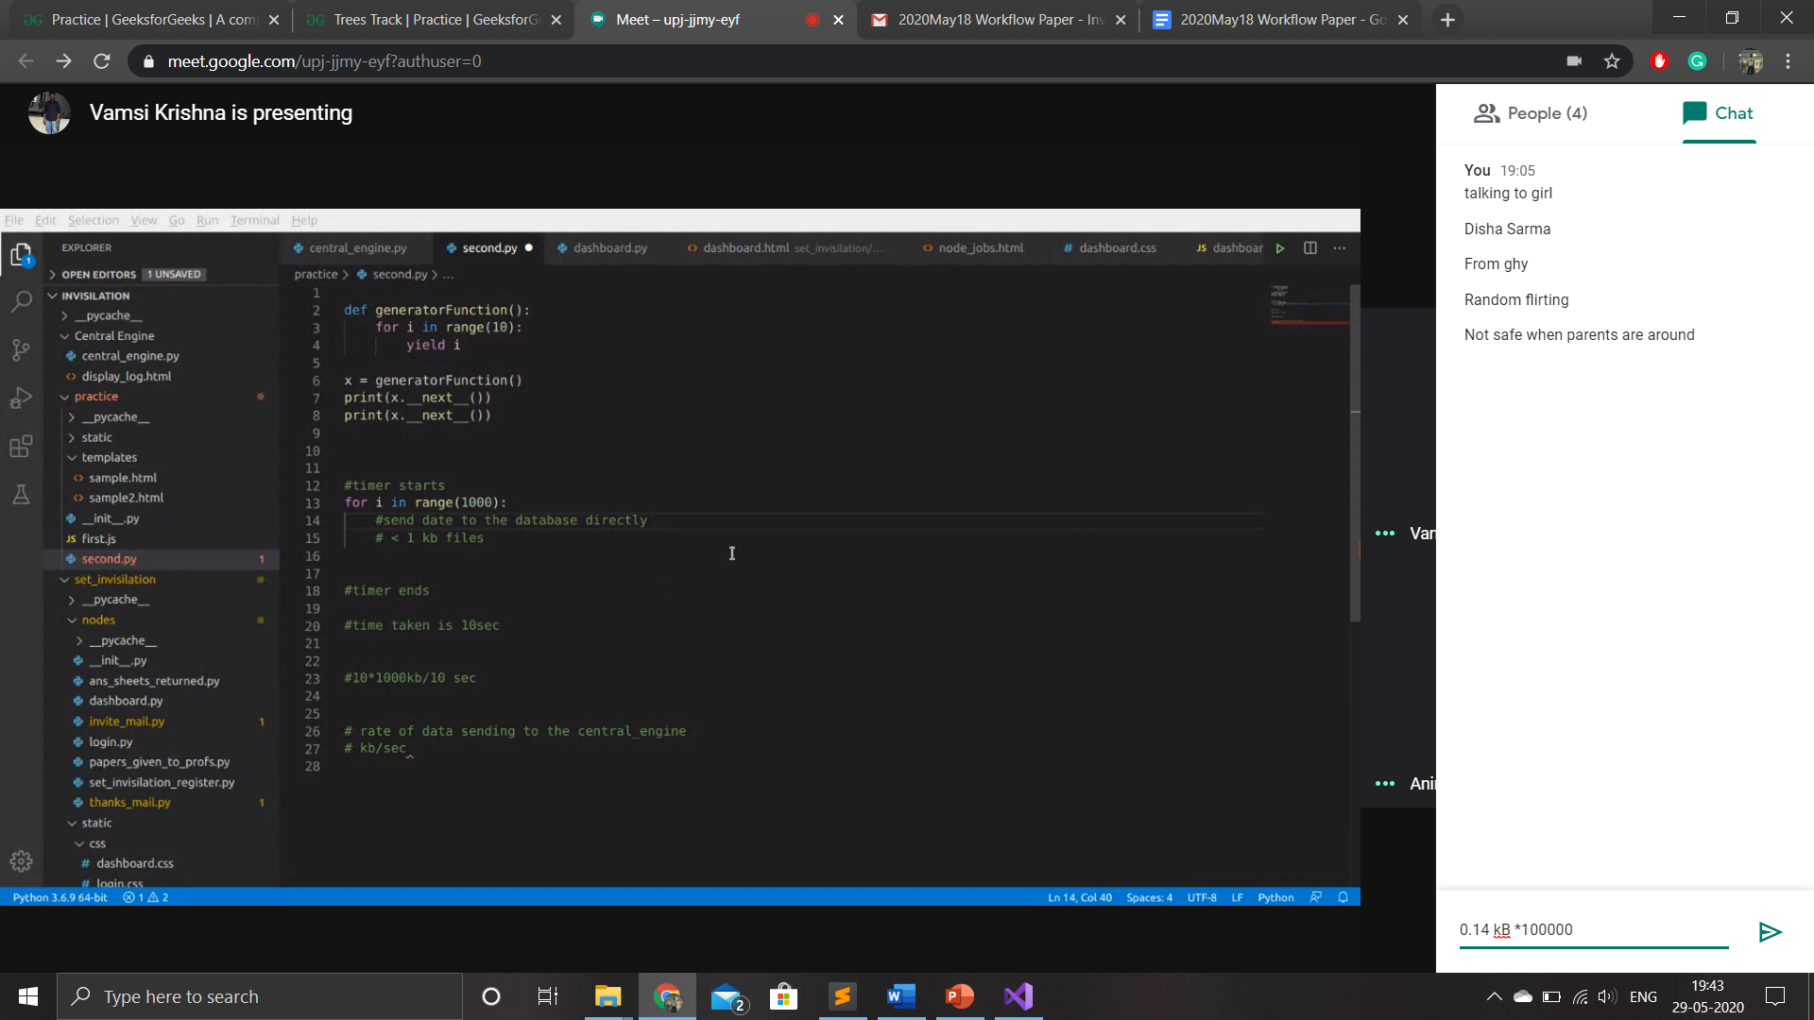
2.Input data processing: x axis
How to calculate execution time for python

